Slide 1

BETA
DataScience
Notes:
Introduce Trainers, and have Participants introduce themselves

Slide 2

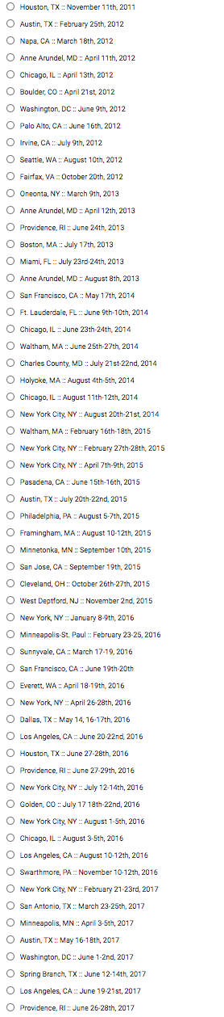
20 Thousand Students Annually
43% Girls and Young Women
46% African-American or Latino
2011

Slide 3
What is Data Science?
Notes:
Equity implications of these points

Slide 4
Design Principles
Principle 1: It should be authentic
Principle 2: It should be accessible
R?
Looping through 2D Arrays?
Notes:
Equity implications of these points

Slide 5
Authentic & Accessible
Build a DS tool made for learning!
Easy importing from Google Sheets
Make tables as easy as numbers
If tables are values, queries are expressions
You can teach a real DS course – with #NoLoops and #NoArrays!
Getting the tool right is necessary, but not sufficient
www.pyret.org
Notes:
Equity implications of these points

Slide 6
The Austerity Problem

Slide 7
The Austerity Problem
Austerity was based on recommendations from economists
Those economists created a giant Excel spreadsheet to analyze historical data
“Backed by millions of data points” sounds a lot more convincing than “backed by hundreds of data points”.
There was just one problem…
Notes:
Equity implications of these points

Slide 8
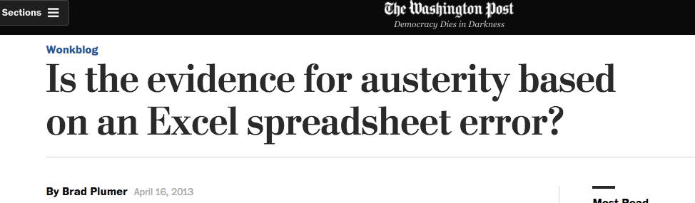
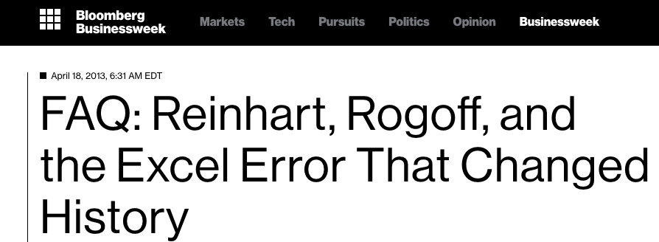
The Austerity Problem
Notes:
Equity implications of these points

Slide 9
The Austerity Problem
Data Science is not about writing for-loops, queries or Excel formulas…
…any more than programming is about “writing code”
Data Science is about analysis, and making sense of data. If all we do is teach kids Excel, R, etc…we fail.
Principle 3: Address the Austerity Problem
Notes:
If it’s more about programming than it is about thinking and writing, we fail

Slide 10
Goals for this Workshop
Understand what “Data Science” is, why it matters
Get comfortable with programming in Pyret
Work through the entire curriculum
Discuss pedagogy
Get your feedback

Slide 11
Bootstrap Materials
Software: In the cloud, or on your machine.
Lesson Plans: Detailed[*] curricula, student handouts, integrated workbooks, and supplemental activities.
Standards: All lessons are aligned to National and State Standards. (e.g. – Common Core statistics)
Language: Algebraic semantics, integrated tables, integrated graphing and plotting

Slide 12
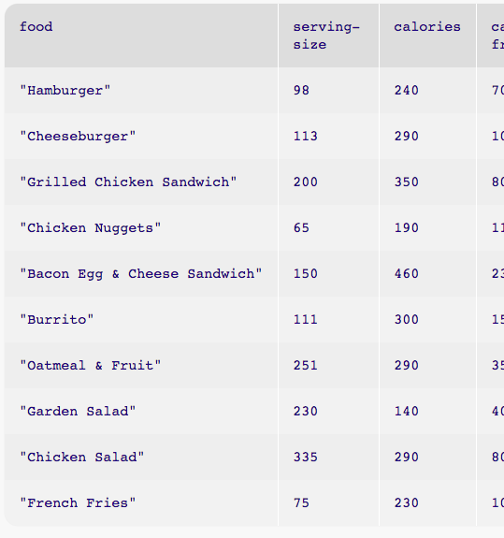
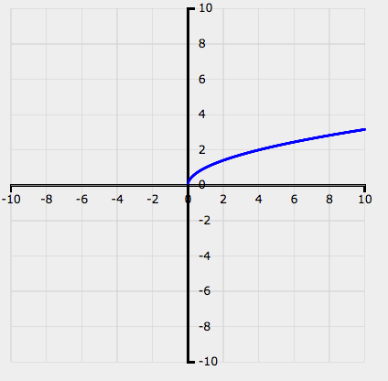
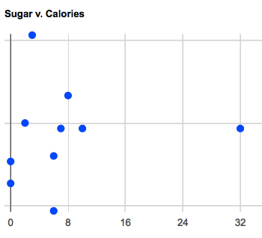
10,000 Foot View
What Questions Matter to You?
Introduction to Pyret, plotting and tables

Slide 13
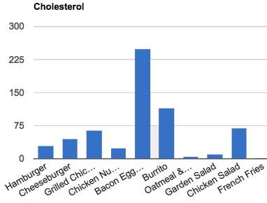
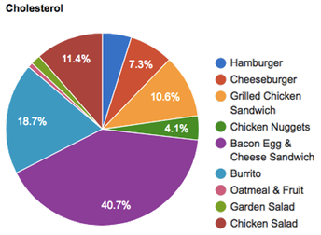
10,000 Foot View
What Questions Matter to You?
Introduction to Pyret, plotting and tables
Measures of Center
Bar and Pie Charts

Slide 14
10,000 Foot View
What Questions Matter to You?
Introduction to Pyret, plotting and tables
Measures of Center
Bar and Pie Charts
Histograms

Slide 15
10,000 Foot View
What Questions Matter to You?
Introduction to Pyret, plotting and tables
Measures of Center
Bar and Pie Charts
Histograms
Line of Best Fit

Slide 16
10,000 Foot View
What Questions Matter to You?
Introduction to Pyret, plotting and tables
Measures of Center
Bar and Pie Charts
Histograms
Line of Best Fit
Selecting and Sorting Tables
Filtering rows with Boolean Expressions
Computing new columns
?

Slide 17
Where Does DataScience Fit?
Data Science Classes
Math & Statistics Classes
Business Classes
Social Studies Classes
AP CS Principles Classes

Slide 18
Agenda
Introduction
Theory
Practice
Pedagogy

Slide 19
Setting up your classroom
Physical Materials (workbooks, pens, etc)
One computer for each pair of students
Gmail Account (per-class? per-pair?)
Log into http://code.pyret.org/
Go to www.BootstrapWorld.org/materials

Slide 20
Unit 1

Slide 21
Do Now
Find a topic that interests you
Choose a question, or create your own
Discuss your answer to the question (2min)
What measurements/data came up? (2min)
Complete Page 1 in your workbook

Slide 22
Numbers and Strings in Pyret
Start a new Pyret Program
Making Numbers
Making Strings
Operations
Turn to Page 2…
Notes:
TYPES
Begin by typing "Ahoy, World!" into the Interactions area, then hit Return. You should see the value "Ahoy, World!" appear on the next line in the Interactions area.
Try to type your name within a pair of quotation marks, then hit Return.
What do you notice about the way Pyret displays Strings on the screen?
Type this program into the Interactions area: "4". Is this a String or a number?
What happens when you leave off the second quotation mark? Type this code into the Interactions area and hit Return: "I love writing programs
Operations (errors w/spaces)
8 + -2
2.3 * 7
6 / 0
2 + "hello"

Slide 23
Error Messages
How we react is key: are we scared or excited?
“The computer is giving you a clue…”
“What do you think it’s trying to tell us…?”

Slide 24
Lists : Groups of Values
[list: “red”, “blue”, “yellow”]
[list: 2, 4, 6, 8]
Lists have brackets and comma-separated values
Every element of a list must have the same Type
The Type of a List is: List<Type-of-Elements>

Slide 25
Functions in Pyret
Math: f(24), g(4, 17)
Pyret: f(23), g(4, 17)
triangle(50, “solid”, “red”)
When using a function, always write its name, then all its arguments (separated by commas).

Slide 26
Back of your Book: Contracts!
Every function has a contract
triangle :: (side::Num, mode::String, color::String) → Image
circle:: (radius::Num, mode::String, color::String) → Image
star :: (radius::Num, mode::String, color::String) → Image
num-sqrt :: (n :: Number) → Number
num-min :: (a :: Number, b :: Number) → Number
string-repeat :: (s :: String, n :: Number) → String
name
Domain (name :: Type)
Range

Slide 27
Definitions in Pyret
Math: x = 4, y = x + 1
Pyret: x = 4, y = x + 1
A = 42 # A :: Number B = “buffalo” # B :: String
C = 2 * 2
D = 42 – A
Turn to page 3…
# C :: Number
# D :: Number

Slide 28
Plotting in Pyret
Add include plot-list at the top of Definitions
New Type, new function:
function-plot :: (f::(Number -> Number)) → DataSeries
draw-plot :: (title::String, ds::DataSeries) → Image
Use them to plot num-sqrt:
# define the series and graph the function f(x)=√x
sqrt-series = function-plot(num-sqrt)
sqrt-graph = draw-plot(“f(x)=√x” sqrt-series)
f is a function!

Slide 29
Plotting in Pyret
You can zoom by drawing a rectangle!
Save your work

Slide 30
Unit 2

Slide 31
Do Now
“What is the relationship between calories and sugar?”
- Write your hypothesis on Page 4

Slide 32
Tabular Data
Not all data is atomic.
We live in a world of structured data!
Restaurant menus
Flight itineraries
Musical playlists
Let’s look at an example
Vocabulary: Rows, Columns and Entries
Header Row
Turn to Page 5…
First | Last | Eye-Color | Height
"John" | "Doe" | "Green" | 52.0
"Jane" | "Smith" | "Brown" | 49.1
"Javon" | "Jackson" | "Brown" | 57.7
"Angela" | "Enriquez" | "Hazel" | 52.5
"Jack" | "Thompson" | "Blue" | 53.0
"Dominique" | "Rodriguez" | "Hazel" | 51.1
"Sammy" | "Carter" | "Blue" | 56.2
Notes:
All the data in a column has one type

Slide 33
Tables in Pyret
Open the Unit 2 Starter File
Save a Copy
Click Run
What definitions do you see?
Loading spreadsheets and tables

Slide 34
Quantitative v. Categorical
First | Last | Eye-Color | Height
"John" | "Doe" | "Green" | 52.0
"Jane" | "Smith" | "Brown" | 49.1
"Javon" | "Jackson" | "Brown" | 57.7
"Angela" | "Enriquez" | "Hazel" | 52.5
"Jack" | "Thompson" | "Blue" | 53.0
"Dominique" | "Rodriguez" | "Hazel" | 51.1
"Sammy" | "Carter" | "Blue" | 56.2
Quantitative data answers “How much?”
Categorical data answers “Which one?”
Turn to Page 6…

Slide 35
Extracting Lists From Tables
sodium-list = extract sodium from nutrition end
What is the type of sodium-list?
Define state-list, which contains the state column from presidents
Define calories-list, which contains the calories column from nutrition
Define sugar-list, which contains the sugar column from nutrition
List<Number>

Slide 36
Scatterplots
scatter-plot :: (xs::List<Num> ys::List<Num>) → DataSeries
sugar-v-calories = scatter-plot(calories-list, sugar-list)
plot-img = draw-plot(“Sugar v. Calories”, sugar-v-calories)

Slide 37
Back to our Question…
“What is the relationship between calories and sugar?”
- Write your answer on Page 4

Slide 38
Project: Choose Your Dataset!
Choose a dataset that interests you
We’ll be adding more
You can find your own (data.gov, google, and other sources)
You can collect your own using Google forms!
What question do you have about this dataset?
Open and Save a Copy of the Starter File and Final Report for your dataset
Complete Questions 1-3 in your Project Report

Slide 39
Unit 3

Slide 40
Review - scatter-plot contract
Review scatter-plot contract
scatter-plot :: (xs::List<Num>, ys::List<Num>)→DataSeries
Review workflow for scatter plot
extract x-axis list
extract y-axis list
produce scatter-plot data series
display scatter-plot with draw-plot

Slide 41
Practice with scatter-plot
Yesterday we wondered if there the serving size of the food item was producing inaccurate results.
Use the nutrition table to examine whether there is a relationship between the serving size and another column.

Slide 42
Bar and Pie Charts
Open the Unit 3 Starter File
Let’s go through the code together…
What new functions do you see here?
What are their contracts?
Practice reading your charts on Page 8
bar-chart :: (labels::List<String>, values::List<Number>)
→ DataSeries
pie-chart :: (labels::List<String>, values::List<Number>)
→ DataSeries

Slide 43
Frequency Bar Charts
Turn to Page 9…
What’s different about this bar chart?
freq-bar-chart :: (values::List<String>) → DataSeries
Create a frequency chart chart for the party column in the presidents dataset.
Create a frequency chart chart for the continent column in the countries dataset.
For more practice reading charts, complete Pages 10-13
Notes:
By filling in the last bar, you have created a bar chart. However, there’s something special about chart. What is different about this bar chart from the ones we have created before?
Previous bar charts used a column from the table as the labels, and another column as the values.
In this bar chart, we are using the categories of a column as the labels, and the frequency of each category as the value.
Here, we are looking at the Eye Color column, which contains categorical data. In this special kind of bar chart, we are computing the frequency of each category, and that frequency relates to the length of each bar. Since there are 3 people with brown eyes, the bar for Brown extends to 3 marks long.

Slide 44
Project: Visualizing Your Dataset
Open your Final Project files (code and report)
Use the new visualization functions you’ve just learned to work with your dataset.
Answer Questions 5 and 6

Slide 45
Unit 4

Slide 46
Do Now
“According to the US Census Bureau, the average American household earned more than $45,000 in 2003 - more than 3x the poverty line that year. Does that mean only a small percentage of Americans were in poverty that year?”
- Write your hypothesis on Page 14

Slide 47
New Dataset: Countries
Open the Unit 3 Starter File
Save a Copy and click Run
Review:
What tables are being loaded here?
What are the columns of countries?
Are they categorical or quantitative?
What do they tell us about each country?

Slide 48
Review
a = [list: 1, 1 , 4]
What is the Name of this list?
What is its Type?
b = [list: [list: 1, 2], [list: 3, 4]]
What is the Name of this list?
What is its Type?
List<Number>
List<Number>
List< >

Slide 49
Mean
The Mean is the sum of the elements of a list, divided by the length of the list.
Turn to Page 15…
Pyret has a mean function! What do you think its contract is?
mean :: (l :: List<Number>) → Number
mean([list: 1, 2, 3, 4])
How do you take the mean of a? Is that what you wrote?

Slide 50
Median
The Median is the “middle” value of a list of numbers.
What is the median of [list: 2, 3, 1]? Why?
What is the median of [list: 2, 3]? Why?
Turn to Page 15…
Pyret has a median function! What do you think its contract is?
median :: (l :: List<Number>) → Number
median([list: 2, 3, 1])
How do you take the median of a? Is that what you wrote?

Slide 51
Mode
The Mode is the element that appears most often in a list.
What is the mode of [list: 1, 2, 2, 3, 4]? Why?
What is the mode of [list: 1, 1, 2, 3, 4, 4]? Why?
We have several mode functions:
modes :: (l :: List<Number>) → List<Number>
mode-smallest :: (l :: List<Number>) → Number
mode-largest :: (l :: List<Number>) → Number
How do you find the modes of a? Is that what you wrote?

Slide 52
Measuring Center w/Tables
How would we find the mean of the calories column in our nutrition table?
calorie-list = extract calories from nutrition end
mean(calorie-list)
mean(extract calories from nutrition end)
Which style do you like better? Why?
Turn to Page 16…
A
B

Slide 53
Which measure is “best”?
Imagine that a math teacher is tracking their students’ grades. Here are the students’ grades on the first test.
grade-list = [list: 68, 64, 62, 100, 100, 68, 67]
Which measure gives the best indication of how the class did?
mean: 75.57
median: 68
mode: 69
Outliers

Slide 54
Which measure is “best”?
Suppose we want to look at how much sodium is in our menu. Would taking the mean or median be more accurate? Why or why not?
Suppose we want to know how long the average person on Earth lives. Would taking the mean of median-life-expectancy give us the answer? Why or why not?

Slide 55
Back to our question…
“According to the US Census Bureau, the average American household earned more than $45,000 in 2003 - more than 3x the poverty line that year. Does that mean only a small percentage of Americans were in poverty that year?”
- Write your findings on Page 7

Slide 56
Project: Centers of Your Dataset
Open your Final Project files (code and report)
Answer Question 4

Slide 57
Unit 5

Slide 58
Do Now
You find yourself at a Vegas casino. A game costs you $1 to play. The dealer rolls two dice and adds the numbers together, while you guess what number he came up with. If you guess right, you keep your money and get an extra $1 to boot!
But if you guess wrong, you lose
dollar. Should you play?
Write your hypothesis on Page 17

Slide 59
Plotting Probability
What are all the possible numbers we could guess? Are they all “equally likely”, or is there a Lucky Number?
Open the Unit 5 Starter File, Save a Copy, and click Run.
What do the following expressions evaluate to?
roll-dice(1)
roll-dice(2)
roll-dice(100)
What is the contract for roll-dice?
roll-dice :: (rolls :: Number) → List<Number>
Will roll-dice(10) always return the same thing?

Slide 60
Plotting Probability
Use roll-dice(10000) to define a list of 10,000 sample rolls.
What are the mean, median and mode of this list?
7 is certainly the best number, but is it “lucky”?
Will it come up at least 50% of the time, or are we still more likely to with that number?
We need something like a frequency-bar chart…
dice-histogram-series = histogram(roll-dice(10000), 11)
dice-histogram=draw-plot(“dice rolls”, dice-histogram-series)
Notes:
Unfortunately, we still don't know if 7 comes up often enough for this to be a game worth playing! We've used our measures of center to figure out the most frequent number, but just @italic{how frequent is it}? We need some way of asking if 7 appears more than all the other numbers combined.

Slide 61
Bins and Spread
What does the second argument to histogram mean?
What if there were only 2 bins? 40?
Why is 11 ideal?
It accurately covers all possible rolls (it’s “big enough”)
There are no relevant values left out (it’s “small enough”)
Turn to Page 18…
Create a histogram for the calories column in nutrition
Create a histogram for the gdp column in countries
Notes:
Unfortunately, we still don't know if 7 comes up often enough for this to be a game worth playing! We've used our measures of center to figure out the most frequent number, but just @italic{how frequent is it}? We need some way of asking if 7 appears more than all the other numbers combined.

Slide 62
Back to Our Question…
You find yourself at a Vegas casino. A game costs you $1 to play. The dealer rolls two dice and adds the numbers together, while you guess what number he came up with. If you guess right, you keep your money and get an extra $1 to boot!
But if you guess wrong, you lose
dollar. Should you play?
Write your finding on Page 17

Slide 63
More Practice with Histograms
Complete pages 18-19 in your student workbook
Open your Final Project files (code and report)
Answer Question 7
Notes:
Unfortunately, we still don't know if 7 comes up often enough for this to be a game worth playing! We've used our measures of center to figure out the most frequent number, but just @italic{how frequent is it}? We need some way of asking if 7 appears more than all the other numbers combined.

Slide 64
Unit 6

Slide 65
Do Now
“The more you pay at a
restaurant, the better it is.”
Do you agree?
- Write your hypothesis on Page 20

Slide 66
New Dataset: restaurants
name | price | rating
"Family Diner" | 13.21 | 4.5
"Geoff’s Sandwiches" | 10.23 | 4.1
"Best Burger" | 6.52 | 2.9
"Riverside Grille" | 19.56 | 4.9
"Jackie’s BBQ" | 5.57 | 2.3
"La Taqueria" | 9.72 | 4
"Bebop Bar" | 7.2 | 3.3
"Spike’s" | 6.98 | 3.8
"Fred’s Shake Shack" | 5.25 | 3.5
What’s the best-reviewed restaurant? Most expensive?

Slide 67
A return to plotting
Open the Unit 6 Starter File, Save a Copy, and click Run
Define ratings-list and prices-list, by extracting those two columns from the table.
What’s the mean rating of all the restaurants?
Use a histogram to visualize the prices in this table
Create a scatterplot of the prices and ratings
Based on this plot, do you see a pattern – a relationship – between price and rating?
Notes:
By filling in the last bar, you have created a bar chart. However, there’s something special about chart. What is different about this bar chart from the ones we have created before?
Previous bar charts used a column from the table as the labels, and another column as the values.
In this bar chart, we are using the categories of a column as the labels, and the frequency of each category as the value.
Here, we are looking at the Eye Color column, which contains categorical data. In this special kind of bar chart, we are computing the frequency of each category, and that frequency relates to the length of each bar. Since there are 3 people with brown eyes, the bar for Brown extends to 3 marks long.

Slide 68
A return to scatterplots
Is there a trend?
Are there outliers?
Hover over each dot.
Which dot is “Spike’s”?
Complete Page 21…

Slide 69
A return to scatterplots
For practice, make a scatterplot showing the gdp v. median-life-expectancy from countries
Is it positive or negative?
Are there outliers?

Slide 70
Seeing Correlations
Positive v. Negative Correlation
Using the relationship to make a prediction
What rating would we expect a $16 restaurant to have?
Correlations aren’t perfect predictors!
Brainstorm 3 correlations you can think of

Slide 71
Measuring Correlation Strength
Line of Best Fit
Predictor Function
Good v. Bad Predictors
Turn to Page 22…

Slide 72
Linear Regression* and r²
“ish”
#linear-regression :: List<Num>, List<Num> → (Num→Num)
rating-predictor =
linear-regression(prices-list, ratings-list)
linear-regression is a function that produces a function
The function is the “best fit” for all the points in the dataset
Type rating-predictor(0) into the Interactions Area
How could we get the slope and y-intercept of this function?

Slide 73
Correlation <> Causation
Just because two measures seem to co-relate does not mean that one causes the other!

Slide 74
Combining Plots
rating-predictor is just a function (just like num-sqrt).
Review: Plot this function using function-plot
We’d like to combine the scatterplot and the predictor plot
draw-plots :: (title:String, ds::List<DataSeries>)
→ Image
How do we grade this predictor?
r-squared :: (xs::List<Num>, ys:List<Num>, f::(Num→Num))
→ Num

Slide 75
Reflecting
Turn to Page 23…
Return to Page 20, and write down your findings.
Open your Final Project Files (code and report)
Answer Question 8: What kind of correlations would you like to search for in your dataset?

Slide 76
Unit 7

Slide 77
Introduction to Table Queries
Open the Unit 7 Starter File, Save a Copy, and Click Run
Race to explore the new dataset: movies
What was the domestic gross for "Big Hero 6"?
What was the overseas gross for "Up"?
What was the total gross for "Zootopia"?
What year did "Maleficent come out?"
Type movies-selected into the Interactions Area

Slide 78
The select query
keyword
keywords
select title, year from movies end
table operator
desired columns
table
Take notes on Page 45

Slide 79
The select query
In the Definitions Area, complete “Countries and Continents” and “Fat Content”
Complete Page 25 and 26 in your workbook

Slide 80
More Table Queries
Race to answer the following questions:
Which three foods have the most sodium?
Which 3 movies had the highest domestic gross ticket sales?
What are the 3 countries with the smallest population?
Type presidents-ordered into the Interactions Area

Slide 81
The order query
colon
keyword
order movies: title ascending end
table operator
table
name/order pairs
Take notes on Page 45
Open the Syntax Error file, and debug these queries

Slide 82
The order query
In the Definitions Area, complete “Salt Order” and “Population”
Complete Page 27

Slide 83
Combining Queries
What if we want to select and order?
Type studio-and-gross into the Interactions Area
What table is this query using?
Are the rows in this table in any particular order?

Slide 84
Introducing Table Plans
We might want to order by one column, then remove it later.
The order of our queries matters – a lot!
Turn to Page 28…

Slide 85
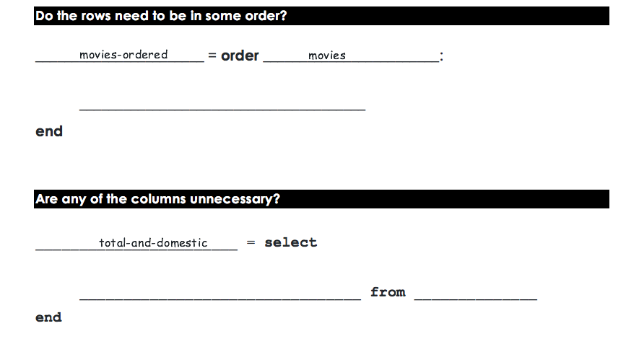
Total-and-Domestic
Title | Studio | Total | Domestic | Overseas | Year
Interstellar | Par. | 675.1 | 188 | 487.1 | 2014
The Sixth Sense | BV | 672.8 | 293.5 | 379.3 | 1999
Man of Steel | WB | 668 | 291 | 377 | 2013
Kung Fu Panda 2 | P/DW | 665.7 | 165.2 | 500.4 | 2011
Ice Age: The Meltdown | Fox | 660.9 | 195.3 | 465.6 | 2006
Title | Total | Domestic
Ice Age: The Meltdown | 660.9 | 188
Kung Fu Panda 2 | 665.7 | 293.5
Man of Steel | 668 | 291
The Sixth Sense | 672.8 | 165.2
Interstellar | 675.1 | 195.3
movies-ordered
“Start” and “End” tables
Examples of our whole dataset, and the desired result
total ascending
Complete the Table Plan on Page 29
title, total, domestic

Slide 86
Final Project
Open your Final Project Files (code and report)
Look at your answer to question 8. Was the correlation what you expected?
Would you have found a stronger correlation (or a different one!) if some of the rows were removed?
Answer question 9

Slide 87
Unit 8

Slide 88
Do Now
“How much of Asia’s GDP does China generate?”
- Write your hypothesis on Page 30

Slide 89
Two missing pieces
How do we write a check? (i.e. – “is this country in Asia?”)
How do we use that check in a query? (i.e. - produce a table containing only countries in Asia)

Slide 90
1. Writing Checks
What will each of the following expressions evaluate to?
5 + 3 4 * 2 3 > 2 8 < (1 + 1)
What is the Type of the value produced from the last two?
true and false belong to a new Type, called a Boolean

Slide 91
1. Writing Checks
What will each of the following expressions evaluate to?
18 > 18
18 >= 18
-5 <= 20
-4 == -4
3 <> 2
(-8 + 8) == 0
(12 - 4) == (-4 + 12)
What is the difference between = and == ?
Turn to Page 31…
How might (continent == “Asia”) be useful to us?

Slide 92
Two missing pieces
✅
How do we write a check? (i.e. – “is this country in Asia?”)
How do we use that check in a query? (i.e. - produce a table containing only countries in Asia)

Slide 93
2. Using check inside queries
Open the Unit 8 Starter File, Save a Copy, and click Run
Type restaurants into the Interactions Area
Type restaurants-sieved into the Interactions Area
What is different about these two tables?

Slide 94
The sieve query
table operator
table
keyword
column arguments
colon
sieve restaurants using rating :
rating >= 3
end
query body
keyword
Take notes on Page 45
Open the Syntax Error file, and debug these queries

Slide 95
Two missing pieces
✅
How do we write a check? (i.e. – “is this country in Asia?”)
How do we use that check in a query? (i.e. - produce a table containing only countries in Asia)
In the Definitions Area, complete low-calorie, ca-presidents and asian-countries.
✅

Slide 96
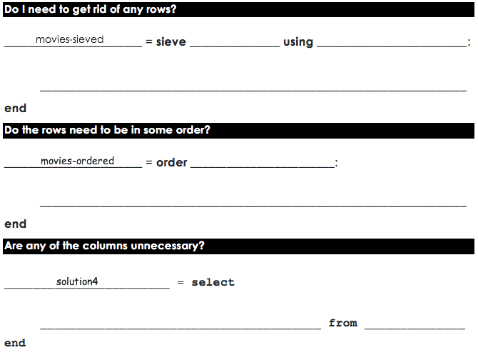
Page 32: Recent Title & Year
Title | Studio | Total | Domestic | Overseas | Year
Interstellar | Par. | 675.1 | 188 | 487.1 | 2014
The Sixth Sense | BV | 672.8 | 293.5 | 379.3 | 1999
Man of Steel | WB | 668 | 291 | 377 | 2013
Kung Fu Panda 2 | P/DW | 665.7 | 165.2 | 500.4 | 2011
Ice Age: The Meltdown | Fox | 660.9 | 195.3 | 465.6 | 2006
Title | Year
Interstellar | 2014
Man of Steel | 2013
Kung Fu Panda 2 | 2011
movies-sieved
movies
year
year > 2011
movies-ordered
total descending
title, year

Slide 97
Page 33: Title and Overseas
Movie Title | Studio | Total | Domestic | Overseas | Year
Interstellar | Par. | 675.1 | 188 | 487.1 | 2014
The Sixth Sense | BV | 672.8 | 293.5 | 379.3 | 1999
Man of Steel | WB | 668 | 291 | 377 | 2013
Kung Fu Panda 2 | P/DW | 665.7 | 165.2 | 500.4 | 2011
Ice Age: The Meltdown | Fox | 660.9 | 195.3 | 465.6 | 2006
Title | Overseas
Ice Age: The Meltdown | 465.6
The Sixth Sense | 379.2
movies-sieved
movies
year
year < 2010
movies-ordered
total asending
title, overseas

Slide 98
Choosing Start/End Tables
Up to now, every Table Plan you’ve seen has included pre-written Start and End tables. Why?
Now it’s time for you to start choose these tables yourself! A good start table has several qualities:
Includes all relevant columns
Includes rows that will be sieved (both true and false)
Includes enough rows to show random ordering
Is properly representative of the entire dataset
The Austerity Problem
Turn to Page 34

Slide 99
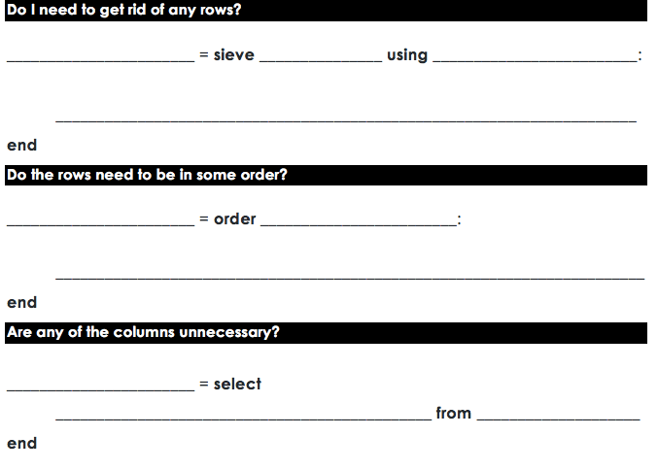
Page 35: Asian GDPs
countries-sieved
countries-sieved
countries
countries-sieved
continent
continent == “asia”
countries-ordered
gdp ascending
countries-selected
country, gdp
Open the Syntax Error file, and debug these queries!

Slide 100
Back to the Do Now
“How much of Asia’s GDP does China generate?”
- Write your findings on Page 30

Slide 101
Unit 9

Slide 102
Do Now
“Is GDP-per-capita positively correlated with life-expectancy?”
- Write your hypothesis on Page 36
Notes:
Discuss – get volunteers.

Slide 103
Easy, right? Well…
Our countries table has total GDP
But all things being equal, larger countries will always have more total GDP.
We need per-capita GDP. How can we calculate this?
We need a way to extend tables, with new columns!
Turn to Page 37…
per-capita-gdp = gdp / population

Slide 104
extend queries
Open the Unit 9 Starter File, Save a Copy, and click Run
What does basketball evaluate to?
What does basketball-extended evaluate to?

Slide 105
The extend query
table operator
table
keyword
column arguments
colon
extend basketball using game1,game2,game3 :
total: game1 + game2 + game3
end
query body
keyword
Take notes on Page 45
Open the Syntax Error file, and debug these queries

Slide 106
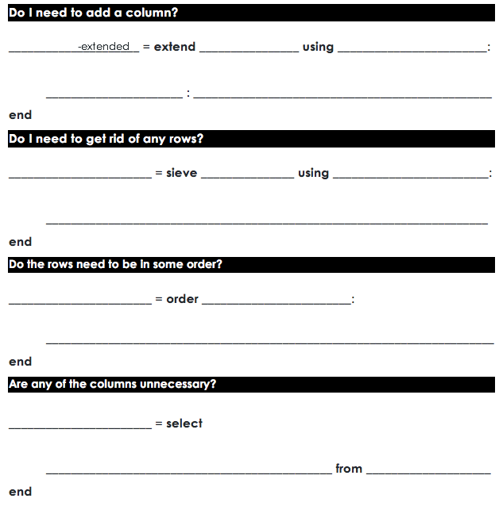
Page 38: body building
nutrition-extended
nutrition
protein, serving-size
protein-per-gram : sodium / serving-size
nutrition-ordered
nutrition-extended
protien-per-gram ascending
nutrition-selected
food, calories, protein-per-gram
nutrition-ordered

Slide 107
Page 39: term length
presidents-extended
presidents
year-started, year-ended
term-length year-ended – year-started

Slide 108
Page 40: gdp v. population
countries-extended
countries
gdp, population
per-capita-gdp gdp / population
countries-sieved
countries-extended
continent
continent == “africa”

Slide 109
Final Project
Open your Final Project Files (code and report)
Finish the remaining question(s)!
Don’t forget to copy/paste any new charts or graphs you create.

Slide 110

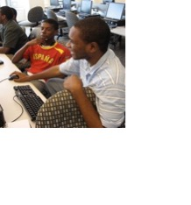

Algebra
Bootstrap:Algebra applies algebraic
concepts and rigorous programming
principles to creating a simple
videogame. Students use order of
operations, function composition, the
distance formula, coordinates and inequalities in the plane to detect collisions, handle keystrokes, and determine how they move and interact – with each challenge framed as a standard word-problem. The module is aligned to National & State Standards for Mathematics, the CSTA standards and K12CS frameworks, and has been shown to improve students’ performance on standards algebraic tasks*.
DataScience
Which artist do you listen to most? Do
schools in richer areas of your town do
better than those in poorer ones? What’s
the healthiest cuisine? Our Data Science
module teaches students to view
programs as questions we ask of data. Students form their own questions about the world around them, and learn to analyze data critically and carefully to find answers. Business, science, and history teachers can utilize this module to help students make inferences from data. Math teachers can use this module to introduce statistics in an accessible way. It also works great as a module for AP CS Principles’ unit on data!
Physics
This module is developed in partnership
with the American Association of Physics
Teachers & American Modeling Teachers
Association. It helps students understand
dynamics concepts by using
programming to build models of the
physical world. The module is targeted at ninth grade, a year in which every student is expected to take science. The module is aligned to the Physics First movement, allowing teachers to present computational modeling as a basic tool to students preparing to study science more broadly.
Reactive
Bootstrap:Reactive goes deeper into
programming, building events and data
structures on top of the foundation laid by
our intro courses and allowing students to
build far more sophisticated programs.
Students learn how the event loop that drives their Bootstrap:Algebra game works, and use it to create animations using simple datatypes. They then learn about data structures, and design a structure for a sophisticated game of their own design. Bootstrap:Reactive is aligned to the CSTA standards and K12CS frameworks.
Notes:
This is just one part of a multi-facet pathway that we at Bootstrap have created. Bootstrap:Physics allows your physics teacher to integrate computing into a standard HS Physics class, and Bootstrap:Reactive allows your students to go deeper into CS by building on – rather than throwing away – what they’ve learned. But there’s also a new trend in CS, which is taking over universities and the corporate world: Data Science. Here are just a few screenshots of major institutions that are pushing for Data Science. And now…Bootstrap is offering an introductory Data Science module for middle or high school, which requires no computing background!

Slide 111


Connect with Us!
/ BootstrapWorld
@BootstrapWorld
Questions:
bit.ly/BootstrapHelp
Grab a photo!

Slide 112
We’d like your feedback!

